Slide 1

Computer Programming for Engineers
Week 6, Midterm Exam
Oct. 6, 2022
Lecturer: Mohammad Mahdi Javidan
College of Engineering, Sungkyunkwan University
Fall Semester 2022

Slide 2
Midterm Exam
Notice:
Don’t use the internet. Answers shall be your own original codes and you cannot use other sources.
Your codes shall produce the test cases, otherwise no credits are given for the test cases that are not generated.
The total point is 100 which accounts for 35% of the final grade.
There are many different questions, try to solve questions based on their simplicity, points, and your time.
College of Engineering, Sungkyunkwan University

Slide 3

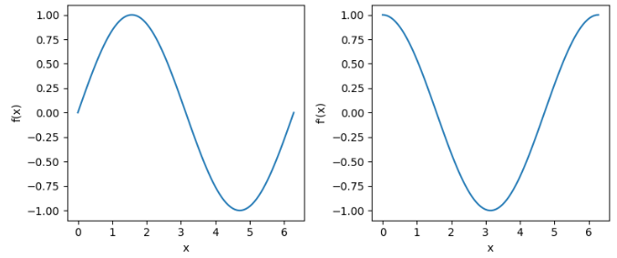
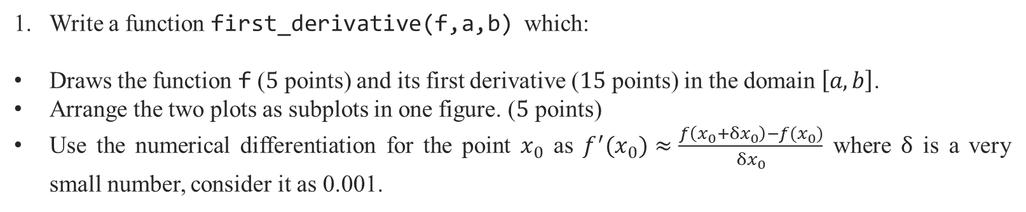
Midterm Exam
Write a function first_derivative(f,a,b) which:
Draws the function f ($5$ points) and its first derivative ($15$ points) in the domain $\left[a,b\right]$.
Arrange the two plots as subplots in one figure. ($5$ points)
Use the numerical differentiation for the point $x_{0}$ as $f^{′}(x_{0})≈\frac{f\left(x_{0}+δx_{0}\right)−f(x_{0})}{δx_{0}}$ where $δ$ is a very small number, consider it as 0.001.
Test Case
College of Engineering, Sungkyunkwan University

Slide 4
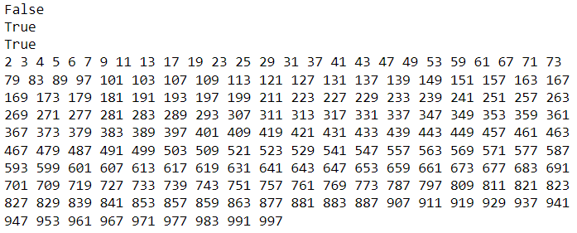
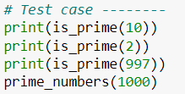
Midterm Exam
Write a function is_prime(a), which checks whether the number a is prime or not. A prime number is a natural number greater than 1 which is only divisible by itself and 1.
The input a shall be greater than or equal to 2, otherwise the function needs to raise an error. (5 points)
The output shall be the Boolean variable True if the input a is a prime number, otherwise False. (10 points)
Write a function prime_number(n) which prints out the prime numbers less than n using the function is_prime(a). (10 points)
Test Cases
College of Engineering, Sungkyunkwan University

Slide 5


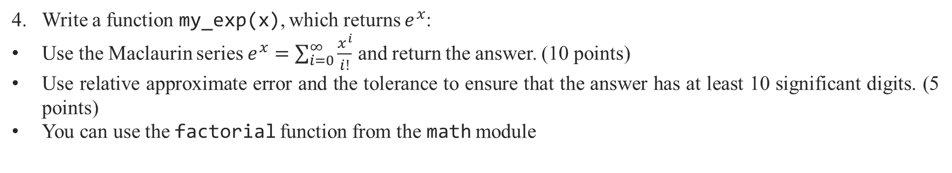
Midterm Exam
Write a function my_exp(x), which returns $e^{x}$:
Use the Maclaurin series $e^{x}=\sum_{i=0}^{∞}{\frac{x^{i}}{i!}}$ and return the answer. (10 points)
Use relative approximate error and the tolerance to ensure that the answer has at least 10 significant digits. (5 points)
You can use the factorial function from the math module
Test Cases
College of Engineering, Sungkyunkwan University

Slide 6
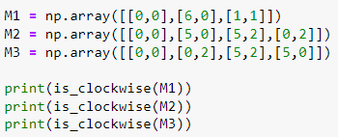


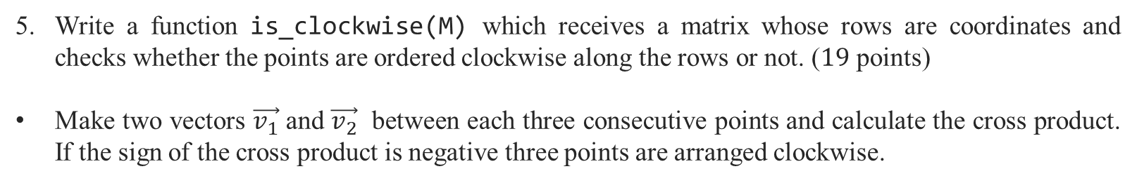




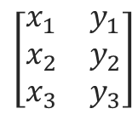
Midterm Exam
Write a function is_clockwise(M) which receives a matrix whose rows are coordinates and checks whether the points are ordered clockwise along the rows or not. ($19$ points)
Make two vectors $\vec{v_{1}}$ and $\vec{v_{2}}$ between each three consecutive points and calculate the cross product. If the sign of the cross product is negative three points are arranged clockwise.
Test Case
$$(x_{3},y_{3})$$
$$\left[\begin{matrix}x_{1} & y_{1} \\ x_{2} & y_{2} \\ x_{3} & y_{3}\end{matrix}\right]$$
$$\vec{v_{2}}$$
$$(x_{2},y_{2})$$
$$\vec{v_{1}}$$
$$(x_{1},y_{1})$$
College of Engineering, Sungkyunkwan University

Slide 7


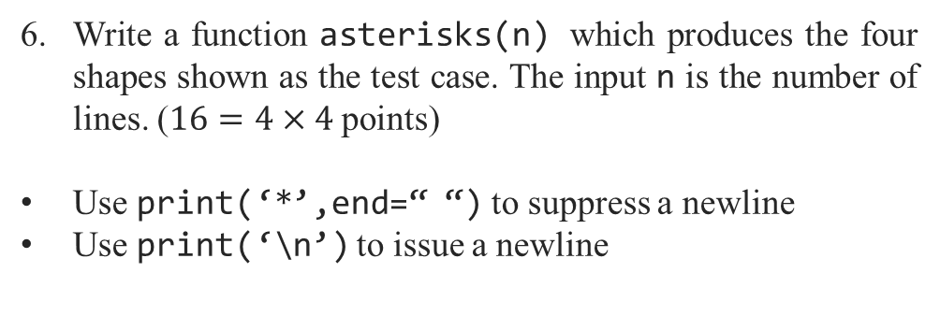
Midterm Exam
Test Case
Write a function asterisks(n) which produces the four shapes shown as the test case. The input n is the number of lines. ($16=4×4$ points)
Use print(‘*’,end=“ “) to suppress a newline
Use print(‘\n’) to issue a newline
College of Engineering, Sungkyunkwan University

